Slide 1
Microsoft Project 2010 – Introduction, Part 1
Phil Pfeiffer
Fall, 2014

Slide 2
Project 2010
Purpose: support project definition, scheduling, tracking
Characterized by some as "heavyweight" tool
Much more fully featured than spreadsheets …
… but with significant learning curve
My take
idiosyncratic
somewhat unstable
inferior, from what I've heard, to other commercial tools
useful, even with all of the difficulties
relatively inexpensive – esp. when compared with these other commercial tools
a reasonable tool for managing projects

Slide 3
Characteristics
Project 2010's world model
A project is a set of partially ordered tasks
Completed with the help of resources (work, materials, costs)
Over time
Fundamental feature: Task Sheet
Hierarchical depiction of a project's tasks, with
Supporting properties: e.g.,
Task name
Start/ end dates
Resources that task requires (people, equipment, …)
Predecessor tasks
Supporting operations: e.g.,
Linking of projects to subprojects
Automated scheduling of tasks, a.k.a. leveling
Automated computation of resource usage and costs

Slide 4
Selected Supporting Features
Gantt Chart – task sheet, with graph depicting
tasks in time, with support for expressing and managing
inter-task dependencies and resource allocations
Resource Sheet – table of resources and characteristics; e.g.,
cost per hour – standard time and overtime
working calendar
Resource Usage – breakdown of usage by resource; e.g.,
summary of usage for project as a whole, in (e.g.) minutes
breakdown of usage, relative to a time-slot-based view of project time
Team Planner – table-based breakdown of resource usage
Network Diagram – graphical representation of task flow

Slide 5
This Presentation's Structure
Part 1
Common features & their uses
Gantt Chart View
Tasks
Scheduling Modes: Manual Mode
Inter-Task Dependencies
Resources
Other Operations on Tasks
Part 2
Common features, uses (cont.)
Overallocation
Duration, Units, Work
Scheduling Modes: Auto Scheduling
Scheduling Modes: Recommendations
Part 3
Common features, uses (cont.)
Summary tasks and subtasks
Summary Tasks: Auto Scheduling
Summary Tasks: Inter-Task Dependencies
Calendars
Calendar Management
Part 4
Common features, uses (cont.)
Calendar Management (cont.)
Modifying Calendars
Skewed Calendars
Calendar Architectures
Project Tracking
Key limitations and gotchas

Slide 6

Common Features and their Uses

Slide 7
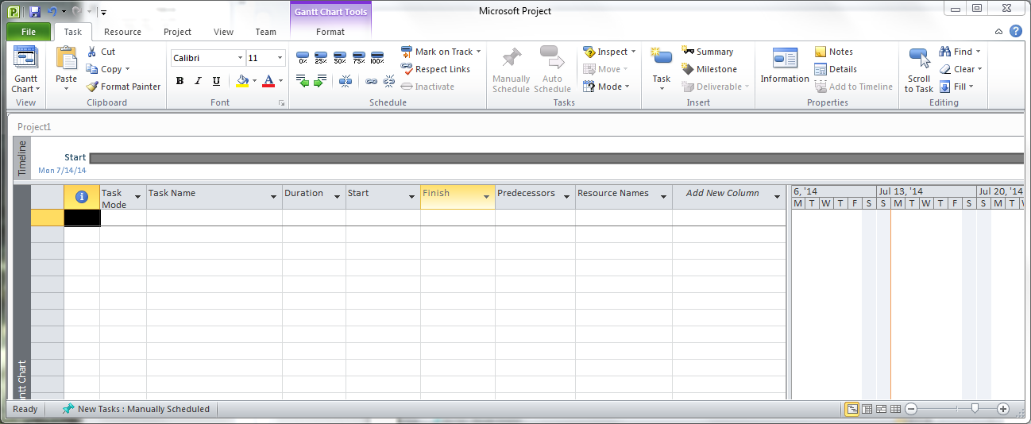
Project's Primary "Face" - Gantt Chart View
Image of initial blank project
Task Sheet (left) divided by sliding bar (center) from Gantt Chart (right)
Task sheet, Gantt chart initially empty

Slide 8
Gantt Chart View: Initial, Blank Project
Gantt chart view also includes a timeline view of project schedule
Timeline view, like task sheet and Gantt chart, initially empty

Slide 9
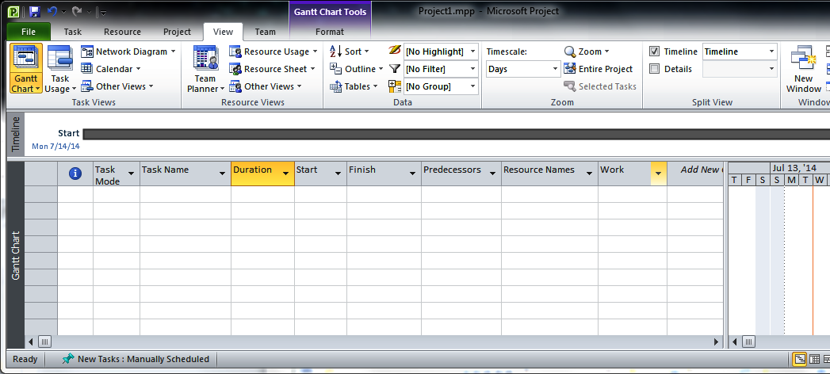
Gantt Chart View: Initial, Blank Project
Timeline view can be disabled and reenabled using View Tab's Timeline Control

Slide 10
Gantt Chart View: Initial, Blank Project
Task sheet 's initial mix of properties shown here
Eight of 427 possible task-related fields that Project 2010 supports
These defaults appear to be hard-wired into Project 2010

Slide 11
Gantt Chart View: Initial, Blank Project
First and final additional task sheet columns
show current row's line number for nonempty rows
support addition of more fields to view

Slide 12
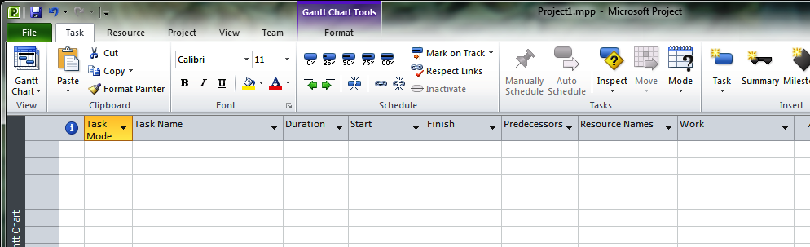
Gantt Chart View: Initial, Blank Project w. Work
Work column shows a task's total workload
Added to default display by
Selecting down arrow on right-hand side of "Add new column" column
Selecting "work" from alphabetized, pop-up list
Useful for seeing how duration and resource parameters affect schedule

Slide 13
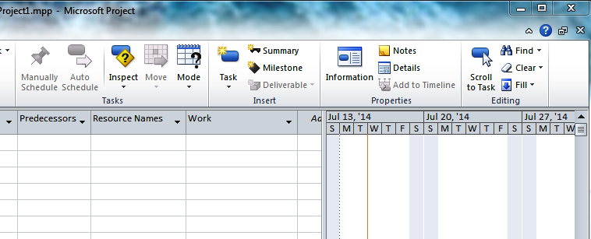
Gantt Chart View: Initial, Blank Project
Gantt chart's initial time frame and display shown here
Two-level breakdown of time, by day (bottom level) and week (top level), starting with current day
These defaults appear to be hard-wired into Project 2010

Slide 14
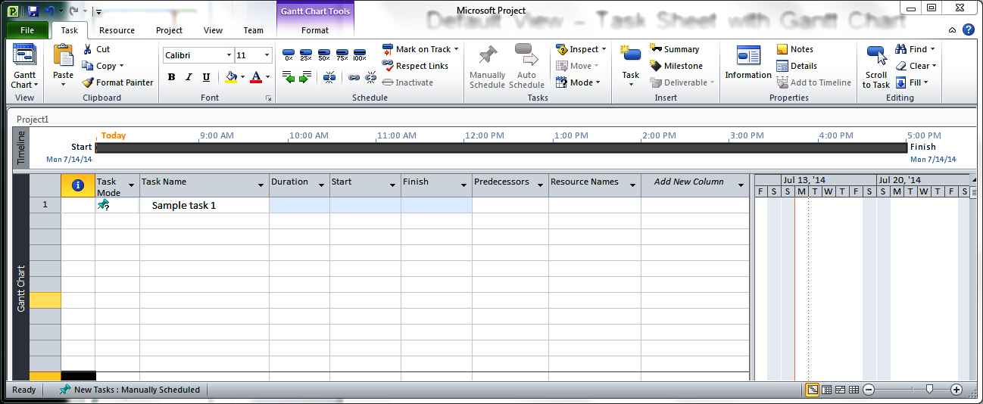
Gantt Chart View: A First, Minimal Task
New task defined by typing task name into Task Name column

Slide 15
Gantt Chart View: A First, Minimal Task
On task creation, Project
initializes line number field
notes scheduling mode in Task Mode field

Slide 16
Gantt Chart View: A First, Minimal Task
Line numbers support definition of ordering constraints
Used in predecessor fields to link related tasks
Convenient for tracing sequences of related tasks in a schedule
Project propagates changes to relative task position to predecessors column automatically – like what happens in Excel

Slide 17
Gantt Chart View: A First, Minimal Task
Task mode field shows mode that Project uses to schedule this task
icon indicates manually scheduled task

Slide 18
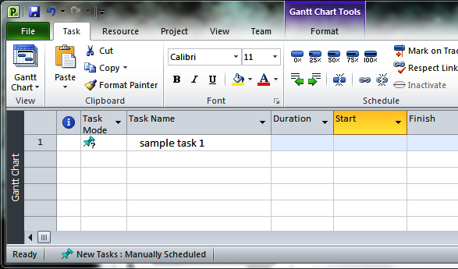
Gantt Chart View: A First, Minimal Task
Scheduling mode assignment for newly created tasks controlled by Task mode control on lower toolbar

Slide 19
Project Scheduling Modes: Manual Mode
One of two Project 2010 modes for scheduling tasks
New in Project 2010
Intended use: building initial list of tasks before estimating them
Default for new projects
Selected characteristics
Allows users to put any text in time-related fields, including
No content at all
Content that Project 2010 can't parse: e.g., "soon", "eventually"
Content that Project 2010 can parse
Time points in various formats: e.g., 7/14/14
Durations in various formats: e.g., 2h, 3 days
Mode's scheduling logic uses well-formed duration, start, and finish fields to automatically derive dependent fields: e.g.,
Derive duration from start and finish dates
Derive start date from duration and finish date
Derive finish date from duration and start date

Slide 20
Gantt Chart View: A First, Minimal Task
Scheduling mode assignment for newly created tasks controlled by Task mode control on lower toolbar
Clicking on control produces dropdown, allows toggling between manual scheduling and auto scheduling (more later)

Slide 21
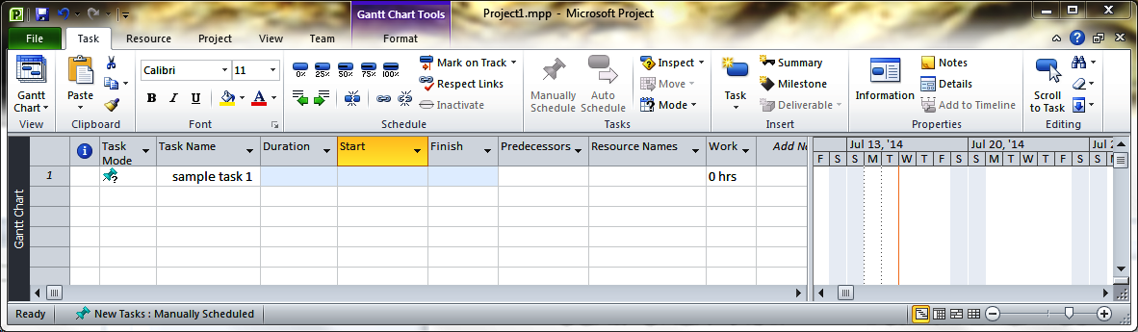
Gantt Chart View: A First, Minimal Task
Project's Gantt Chart remains empty after sample task was added because task lacks duration, predecessor and successor tasks and resource assignments

Slide 22
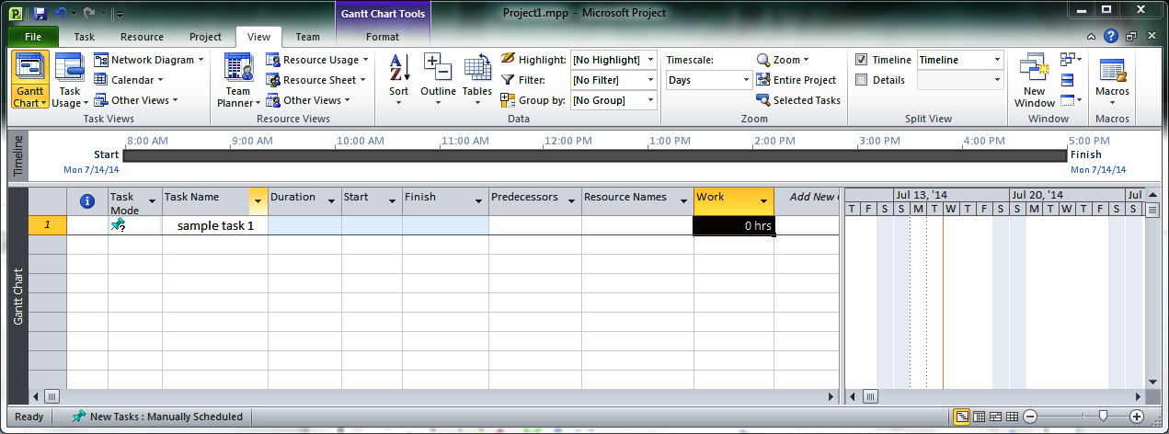
Gantt Chart View: A First, Minimal Task
Similarly, Timeline View remains empty, showing start date equal to finish date (and equal to current date)

Slide 23
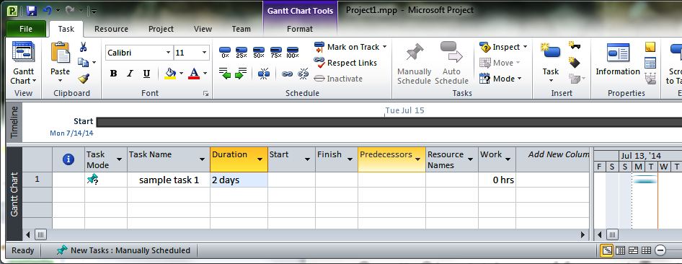
Gantt Chart View: Minimal Task, 2-Day Duration
Adding value to duration field adds blue bar to Gantt Chart
Gantt chart now shows task's duration, using blue bar
Task bar lacks start interval ([) and end interval (]) icons that are present for tasks with explicitly defined start and finish dates.

Slide 24
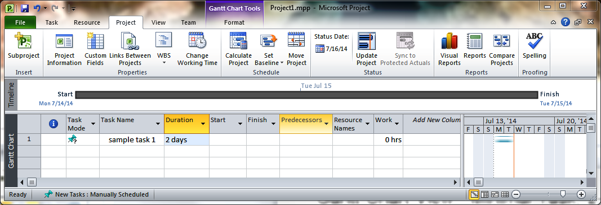
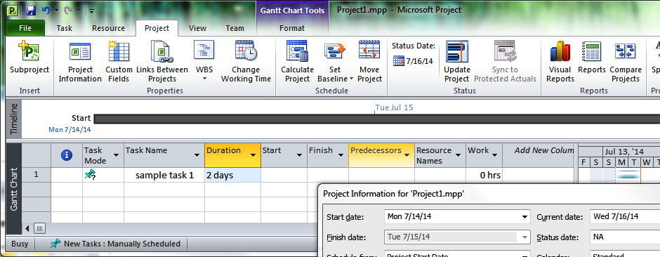
Gantt Chart View: Minimal Task, 2-Day Duration
In absence of well-formed content in Start field, MS Project uses current Project's start date to schedule task 1
Start date viewable, settable from Project Information menu
Tab accessible from Project tab's Project Information option
Defaults to day when .mpp file was created

Slide 25
Gantt Chart View: Minimal Task, 2-Day Duration
Adding value to duration field also updates timeline's start, finish times.

Slide 26
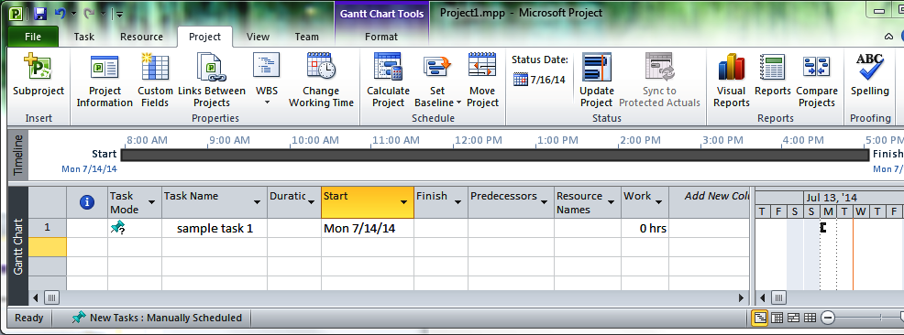
Gantt Chart View: Minimal Task, 7/14 Start
Setting start date of 7/14 with no supporting content inserts start interval icon ([) – and no more – into Gantt Chart

Slide 27
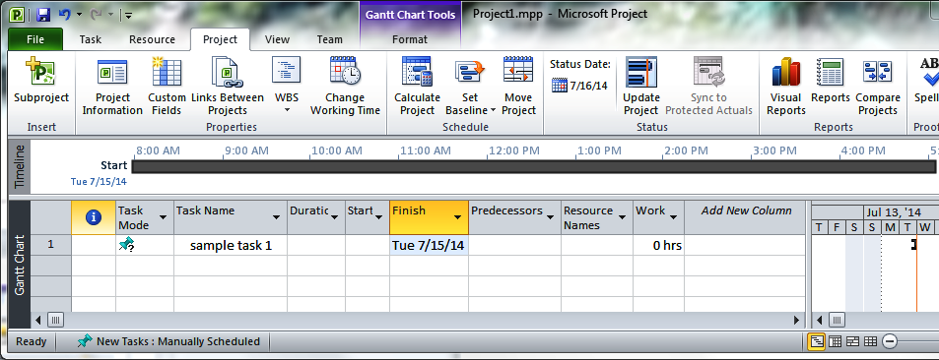
Gantt Chart View: Minimal Task, 7/15 Finish
Setting finish date of 7/15 with no supporting content inserts end interval icon (]) – and no more – into Gantt Chart

Slide 28
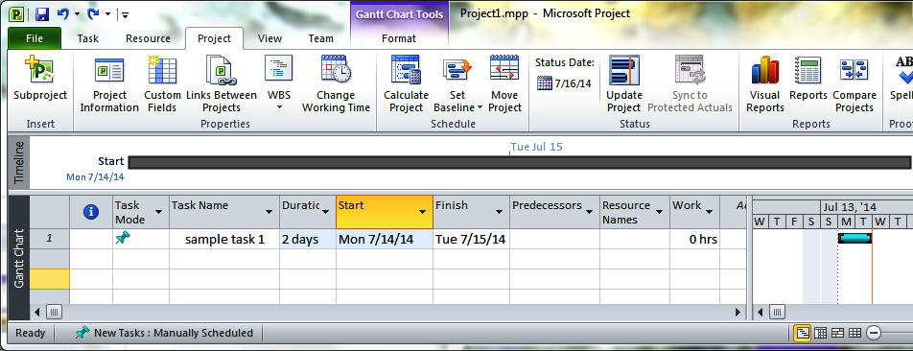
Gantt Chart View: Start, Duration, Finish
If any two of {start date, duration, finish date} is set, Project infers the third value and generates the Gantt chart task bar: i.e.,
start interval icon ([)
blue duration bar
end interval icon (])
Here, I specified start and finish dates and allowed Project to infer duration.

Slide 29
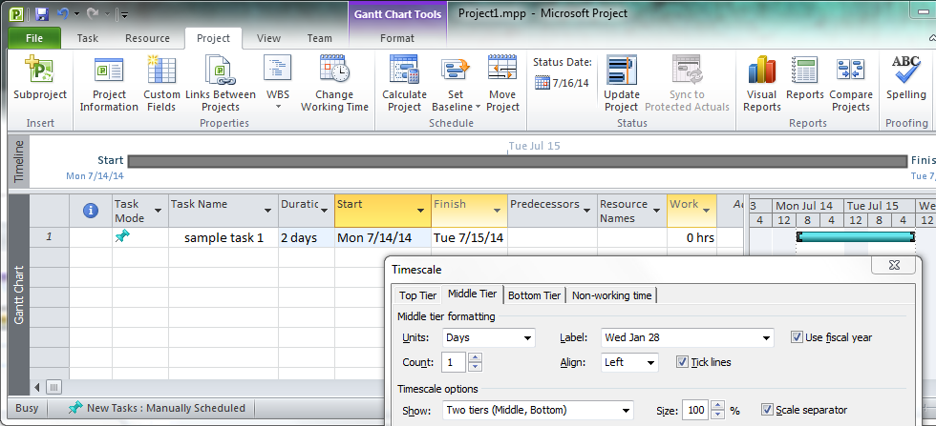
Gantt Chart View: Modifying Timescales
Right-clicking on Gantt chart timescale bar produces pop-up window
Selecting "timescale…" then raises a timescale menu

Slide 30
Gantt Chart View: Modifying Timescales
Timescale menu options support changes to task attributes, including
Tier to vary (via tabs: default is Middle Tier)
Time in units for this tier (via units and count fields)
Number of tiers (default is 2; can be 1 or 3)

Slide 31
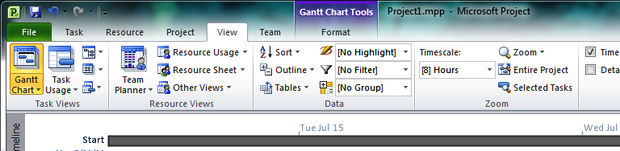
Gantt Chart View: Modifying Timescales
Timescale menu can also be accessed as last item on dropdown menu accessible from View Tab's Timescale option

Slide 32
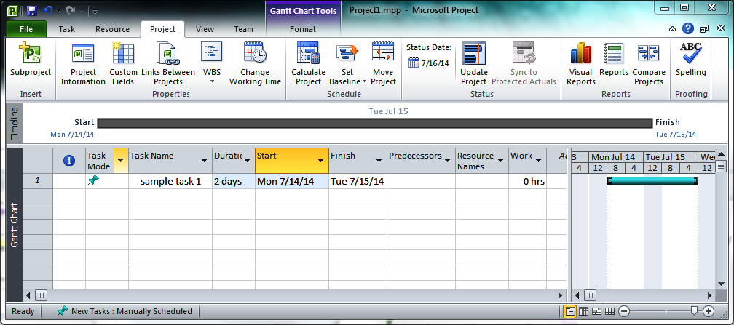
Gantt Chart View: Modifying Timescales
Showing effect of adjusting Gantt chart timescales with
middle tier = 1 day
bottom tier = 8 hours

Slide 33
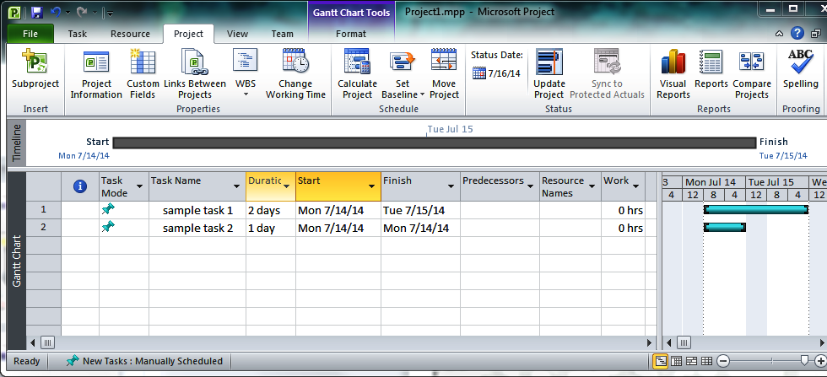
Gantt Chart View: 2 Independent Tasks
Adding second task to schedule with no specified start date schedules task for earliest available start time. Lack of other constraints allows for overlap.

Slide 34
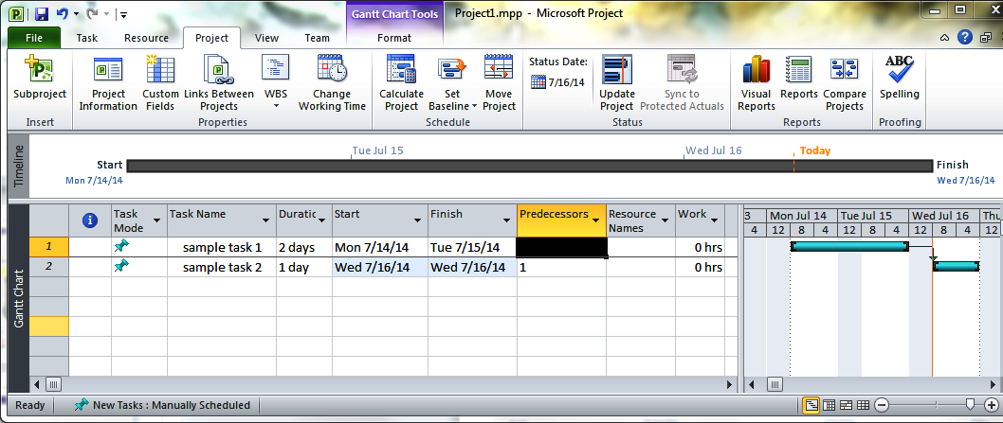
Gantt Chart View: 2 Tasks, FS Dependency
Making sample task 1 a predecessor of sample task 2 yields a three-day schedule.
The Gantt chart uses a small arrow to show inter-task dependency, with arrow pointing towards the dependent task.
Here, task 2 is said to have a finish-to-start (FS) dependency on task 1.

Slide 35
Gantt Chart View: 2 Tasks, FS Dependency
Closeup of Gantt Chart depiction of finish-to-start (FS) dependency from previous slide's schedule.

Slide 36
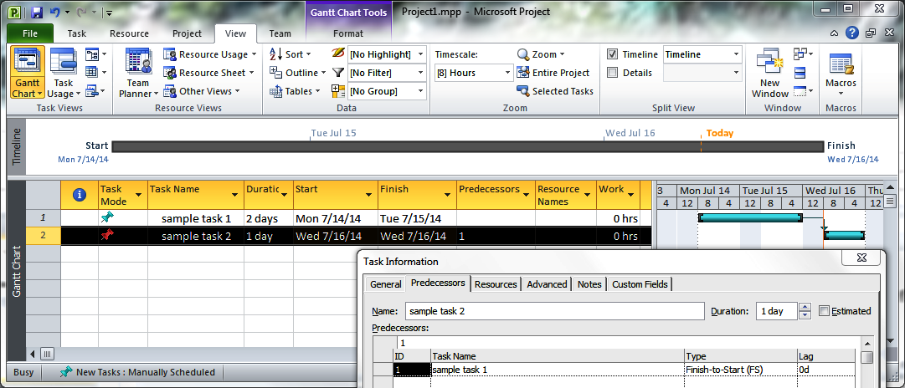
Gantt Chart View: 2 Tasks, FS Dependency
Right-clicking on task 2 raises task 2's Task Information Menu.
This menu's Predecessors tab shows the dependency from task 1 to task 2 and confirms it as an FS dependency.
The FS designation means that task 2 must wait on task 1 to start, subject to a lag/ lead time.

Slide 37
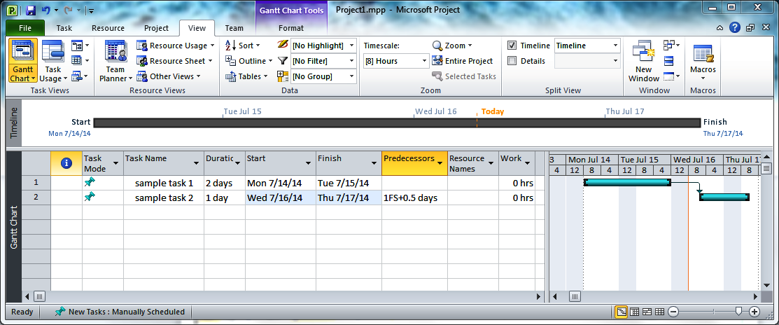
2 Tasks, FS Dependency, 0.5 Day Lag
Lag time is a delay between a first event and a second event that the first triggers.
In Project, lag time is specified using
the task information window OR
by following a predecessor constraint with a "+" and a duration.
The dependency type suffix, FS, can ordinarily be omitted for FS dependencies. It must, however, be shown when specifying a lag.

Slide 38
2 Tasks, FS Dependency, 0.5 Day Lag
Adding the 0.5 day lag time to the task 1-task 2 dependency has the effect of pushing task 2's end time from
the end of the 7/16 work day to
four hours into the work day on 7/17—i.e., 12 noon

Slide 39
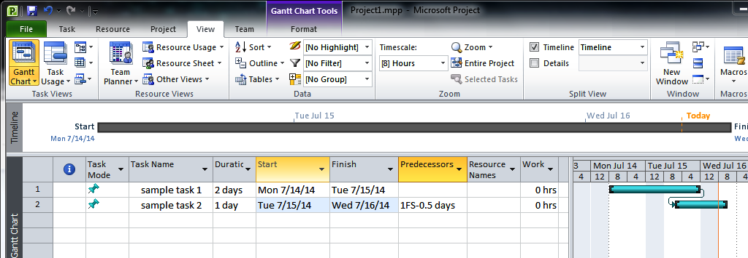
2 Tasks, FS Dependency, 0.5 Day Lead
Lead (pronounced "leed') time is a "head start" given to a second event that a first event triggers.
In Project, lead time is specified as negative lag time.

Slide 40
2 Tasks, FS Dependency, 0.5 Day Lead
Adding the 0.5 day lead time to the task 1-task 2 dependency has the effect of changing task 2's end time from
the end of the 7/16 work day to
four hours before the end of the work day on 7/16—i.e., 12 noon

Slide 41
The Four Types of Inter-Task Dependencies
Finish-to-Start (FS)
End of one task initiates start of another.
Example: when summer ends, students start classes.
By far, the most common type of inter-task dependency.
Start-to-Start (SS)
Start of one task or event initiates start of another.
Example: when semester starts, students start classes.
Start-to-Finish (SF)
Start of one task or event forces end of another.
Example: start of semester puts an end to "normal" life.
By far, the least common type of inter-task dependency
Finish-to-Finish (FF)
End of one task forces end of another.
Example: end of period puts an end to today's lecture.

Slide 42
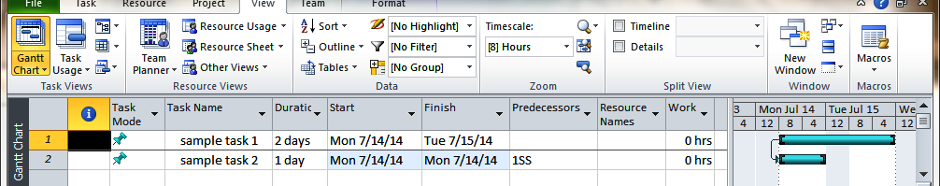
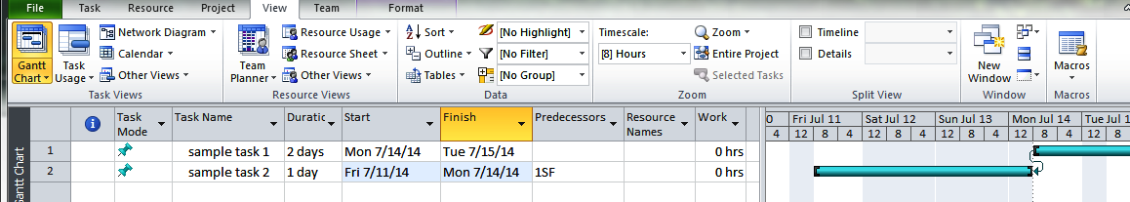
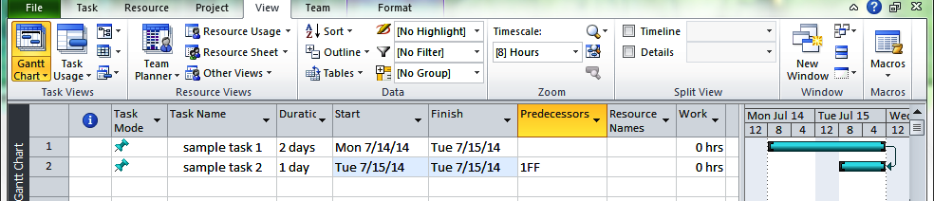
SS, SF, and FF Dependencies

Slide 43
Resources
An entity that's required to complete a project's task(s)
Project recognizes three types:
work
selected by default when a resource is declared
cost
materials

Slide 44
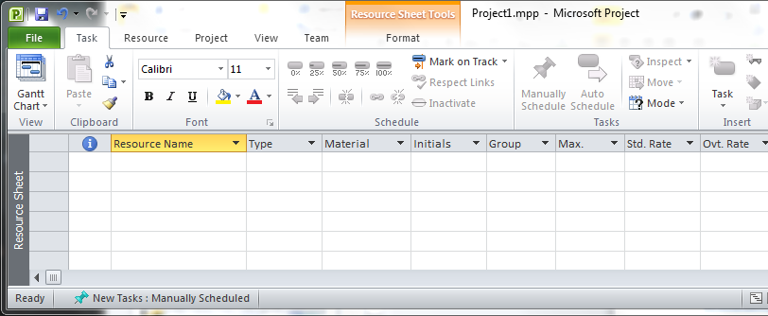
Viewing a Project's Resources
Resource Sheet View
shows a project's resources and their properties
accessed by
selecting Task tab's Gantt Chart dropdown, then
selecting Resource Sheet from the resulting menu
initial, blank project has no assigned resources

Slide 45
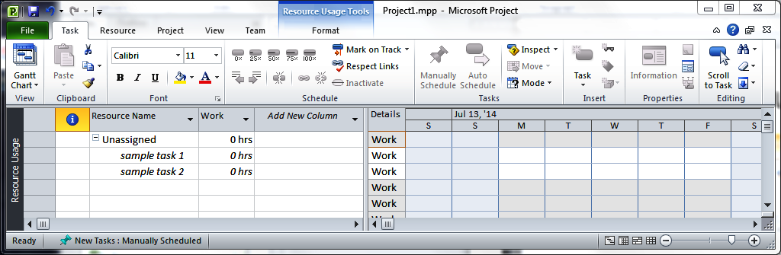
Viewing Resource Usage
Summarized in Resource Usage View
shows a project's resources and uses over a project's lifetime, on a per-resource, per-task basis
first section devoted to resource-less tasks, if any in schedule
accessed by
selecting Task tab's Gantt Chart dropdown, then
selecting Resource Sheet from the resulting menu

Slide 46
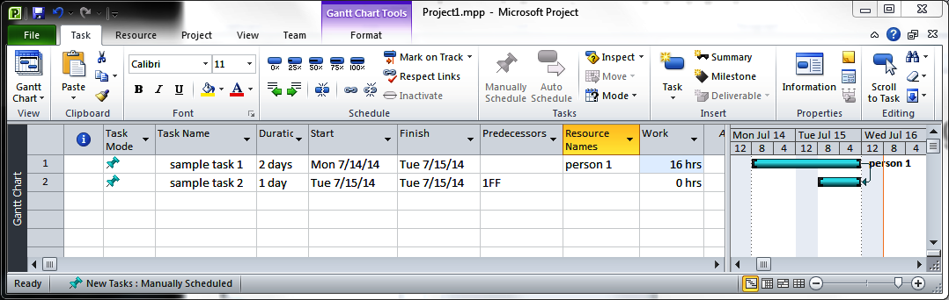
Declaring Resources
Resources can be added to a project by
entering them into the resource sheet OR
naming them into the task sheet's "resource" column (shown here)
Effects of associating task with resource:
update task's work obligation, if duration, start, and finish known
by default, Project associates 100% of resource's time to task
here, 2 day duration * 8 hr default workday = 16 hrs work
place resource name on Gantt chart, next to task's task bar

Slide 47
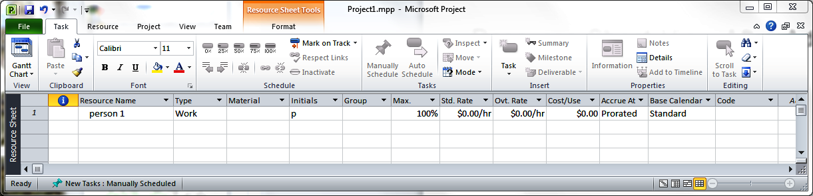
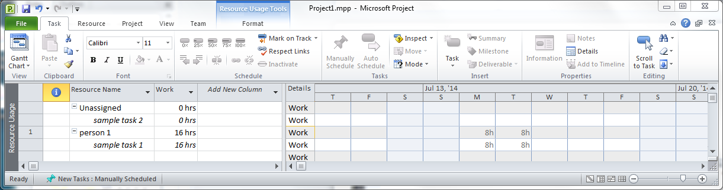
Resource Sheet, Resource Usage Views After Adding Person 1
Top line for each resource shows total usage for resource.
Sample task 2 remains unassigned.

Slide 48
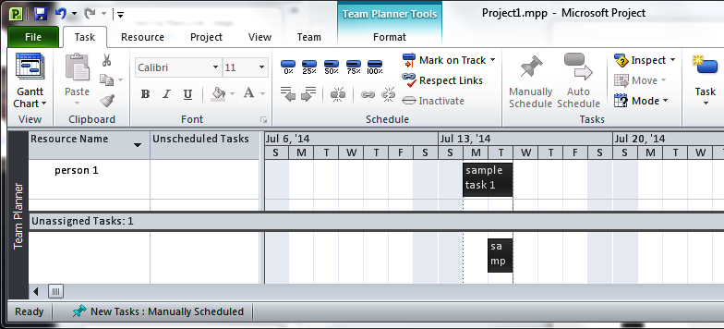
Team Planner View After Adding Person 1
Team Planner view shows tasks by resource over time.
Hovering the mouse over a task rectangle yields a pop-up window that summarizes that task's key characteristics.
View is accessed via the Task tab's View option, via a dropdown menu.

Slide 49
Other Operations on Tasks
Cutting, copying, pasting, and deleting tasks
Operations available through pop-up dropdown menu accessed by right-clicking on task
Options also available via keyboard shortcut keys (^X, ^C, ^V, delete)
Possible to cut, copy, paste, and delete groups of tasks
Pasting groups of cut or copied tasks preserves dependencies within the group
Reordering a project's tasks
Select a task or (or group of tasks) to move
Drag the selection to the new spot in the task list
Note: If the reordering would create a circular dependency (more later), Project will disallow it. If you wish to do a move in this scenario, you will need to break the potential circularity before doing the move.

